Slide 1
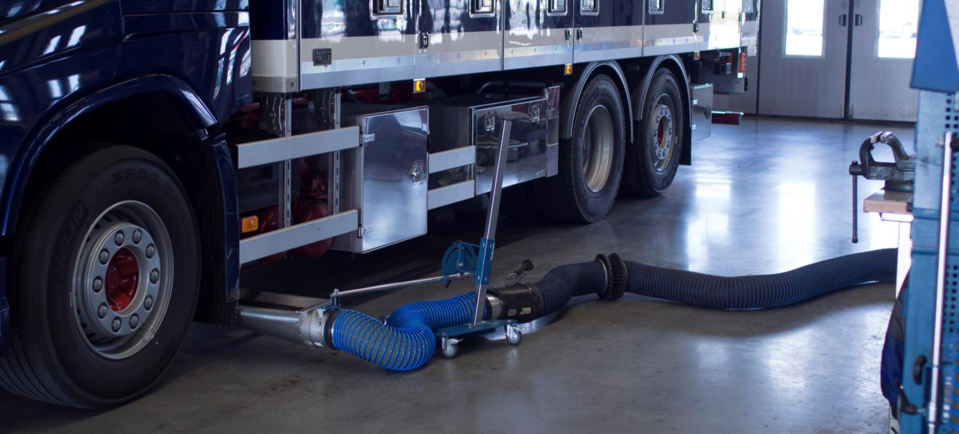
Nederman exhaust extraction nozzle
General information and new on-floor extraction nozzle

Slide 2
Why exhaust extraction nozzles?
Exhaust emissions from a cold-start engine can reach toxic levels within a closed building.
The odorless carbon monoxide (vehicle exhaust) builds up in the building. Even if the vehicles run only a short time indoors and with open doors, .
Without control and removal of the vehicle exhaust fumes they can lead to worker illness, heavier facility maintenance and damage to the sensitive electronics of diagnostic and servicing equipment in the workshop.
Exhaust extraction at source
The most effective method of capturing and removing of vehicle exhaust fumes is capture at source.
Capturing the vehicle exhaust gases provides a safer and more pleasant working environment.

Slide 3
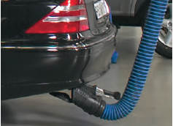
Why use Nederman exhaust extraction nozzles?
Capture at source – most efficient
Safer working environment
Clean and tidy premises
Comply with laws and regulations

Slide 4
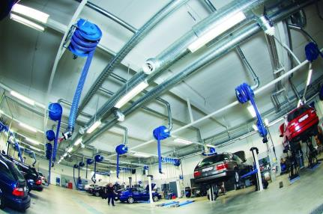
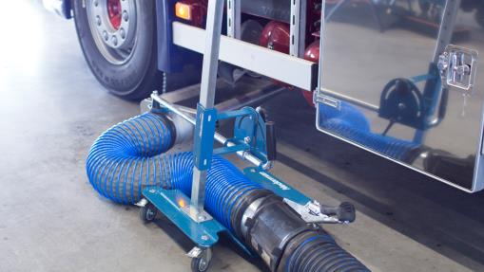
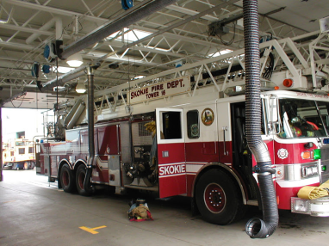
Extraction Nozzles – Typical Applications
Vehicle exhaust extraction for cars, trucks, buses, fire trucks, ambulances and other emergency vehicles
Car repair shops
Truck/bus repair shops
Moving vehicles,
emergency vehicles

Slide 5
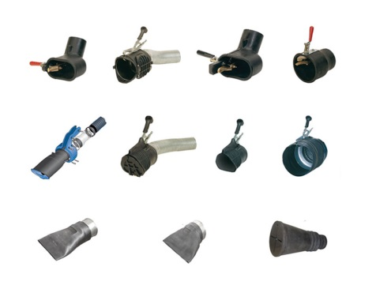
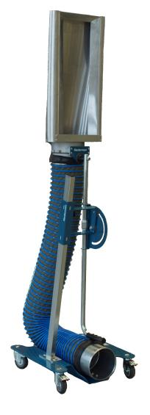
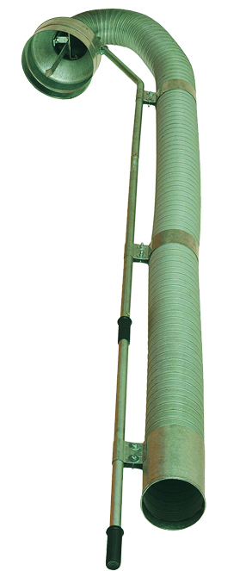
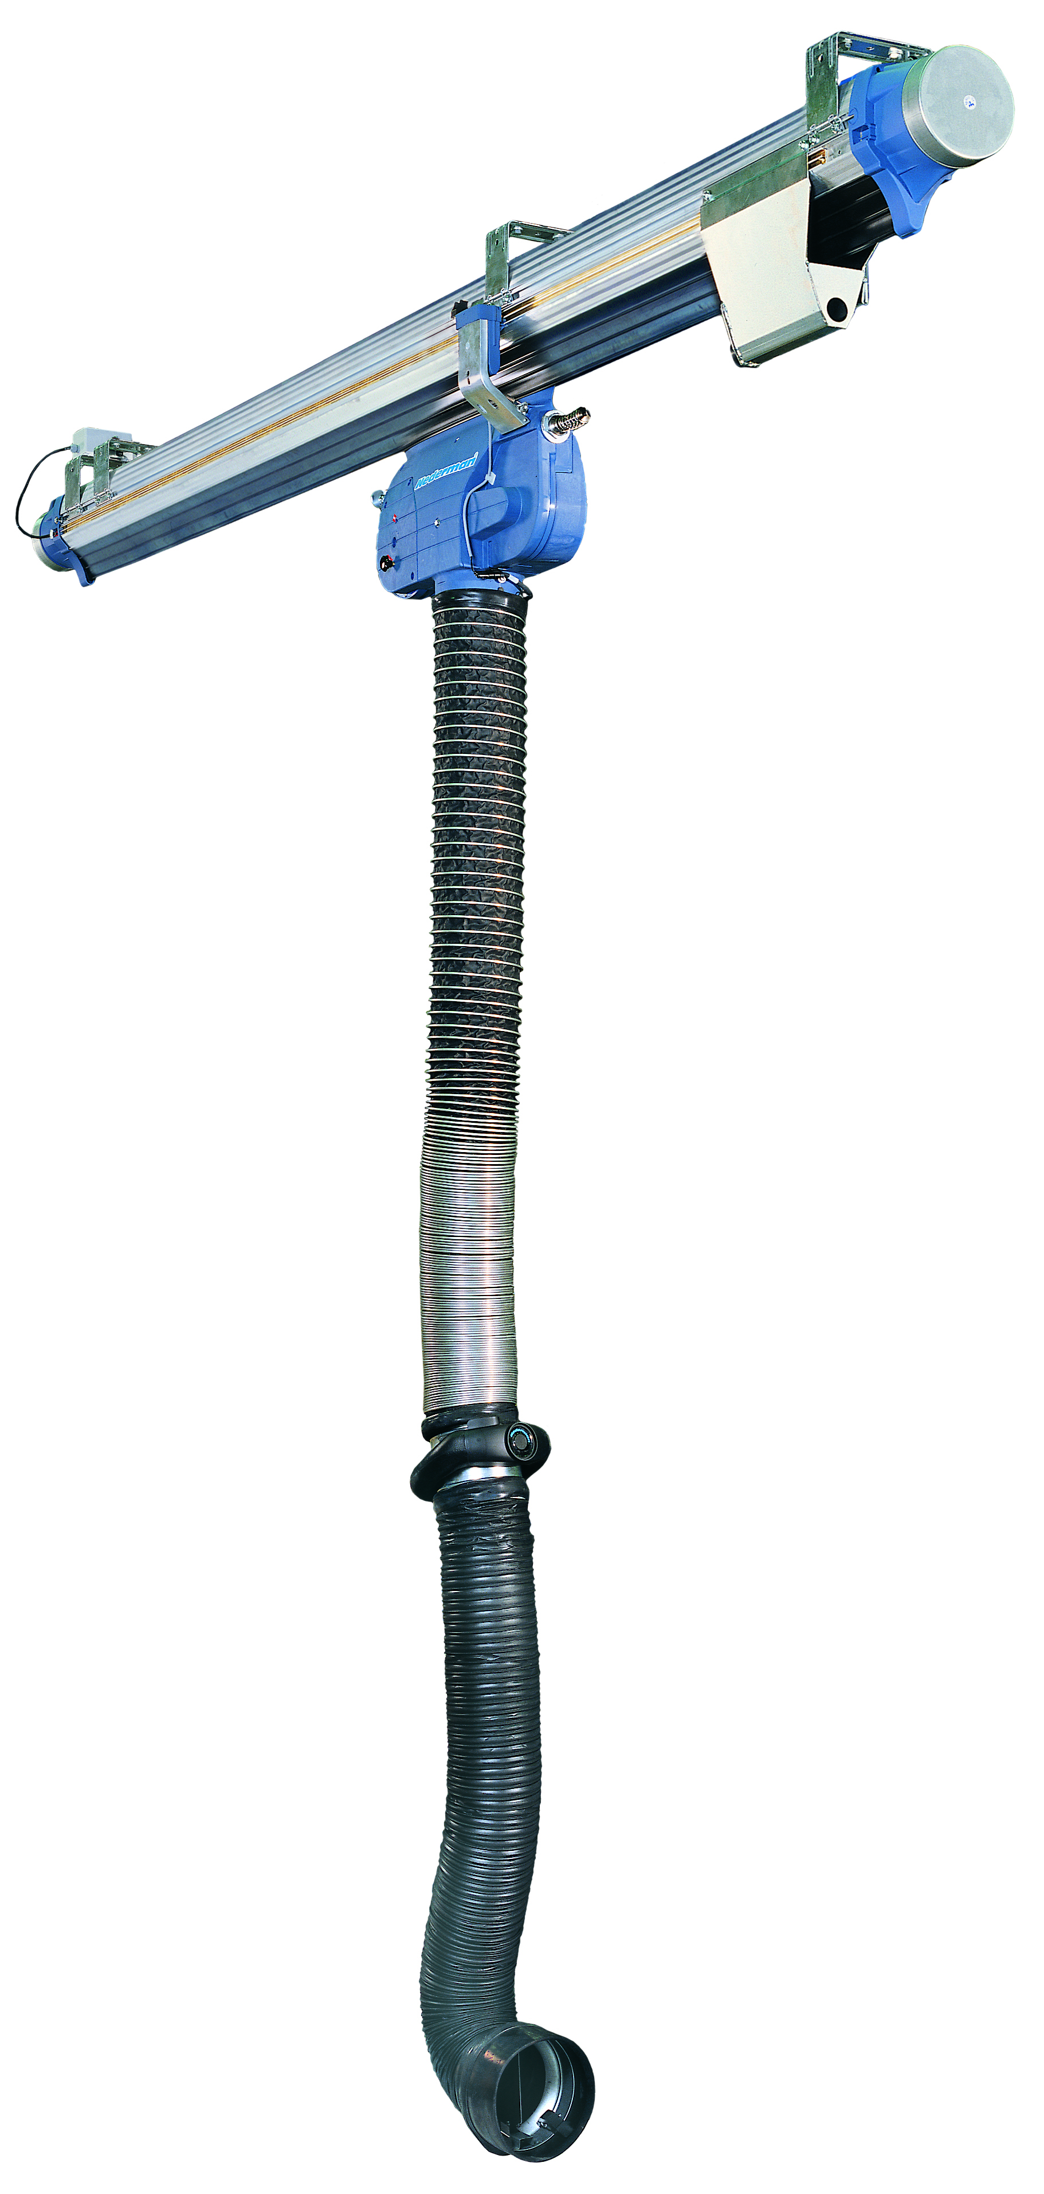
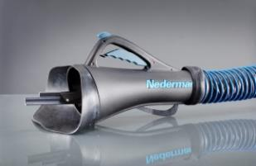
Extraction Nozzles – Overview of the Product Range
Manual disconnection
Rubber Nozzles
Nozzle on floor stand
Vertical exhaust pipe
Automatic disconnection
Rubber Nozzles

Slide 6
Facts about Euro 6
European emission standards define the acceptable limits for exhaust emissions of new vehicles sold in EU member states.
The emission standards are defined in a series of European Union directives
Non-compliant vehicles cannot be sold in the EU, but new standards do not apply to vehicles already on the roads. Euro V was enforced 2008 a Euro VI will be enforced 2014 but vehicles according to the new standard will be delivered during 2012.
The enforcement of the new directive will get the effect that the tailpipes of all new vehicles will be different in shape and formed as well as the position can be different.

Slide 7
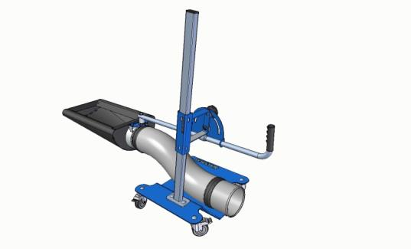
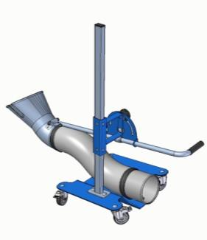
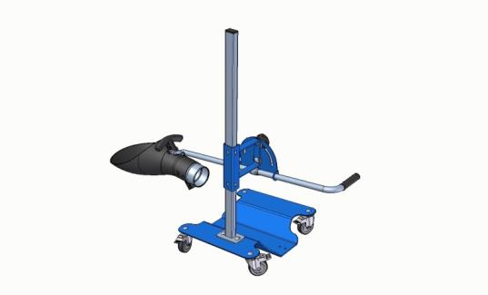
On-floor extraction nozzle
Same Flexible stand with all its advantages, multiple choses of nozzles.
Possibility to develop unique nozzle using same fixation interface.
The new Alu-funnel captures effectively exhaust from a variety of exhaust pipes.
Easy to connect to existing exhaust reels hoses due to standard connectors.
Very movable and adjustable stand for optimal positioning of capture.
Sustainable positioning during use due to low center of mass and rigid fixations.

Slide 8
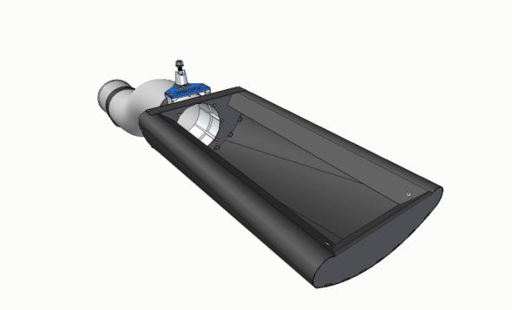
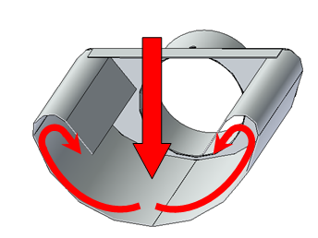

How does the on-floor extraction nozzle work?

Slide 9
Sum up - Advantages
Flexible & User friendly
  Safe and easy to use and install
  Flexible positioning
  Use existing exhaust solution
  Compact and easy to store
Reliable
  Quality components
  Proven fixations solutions
  Durable
Service made easy
  Short and reliable delivery times
  Easy access to spare parts

