Slide 1
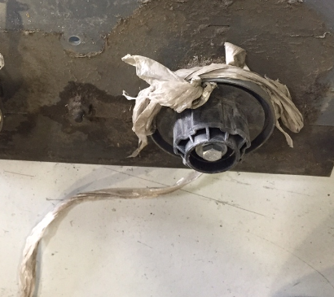
Live Vacuum Wand for M17 and T17
Improved productivity by quickly picking up random debris like shrink wrap, which can get tangled in main brush
Part numbers: 9018415 (T17) and 9018413 (M17)
See QIT for pricing:
Dry vacuum wand excludes following options:
High pressure wand
Vacuum wand
Battery roll-out
Not retrofittable
Don’t
Confuse
with
Vacuum
Wand:

Slide 2
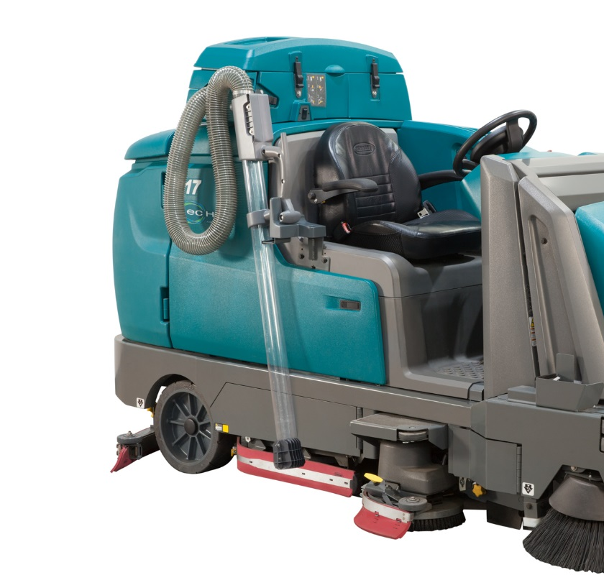
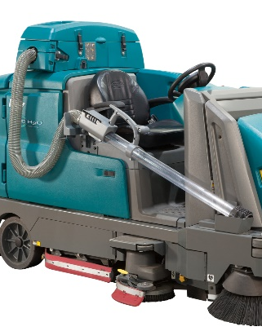
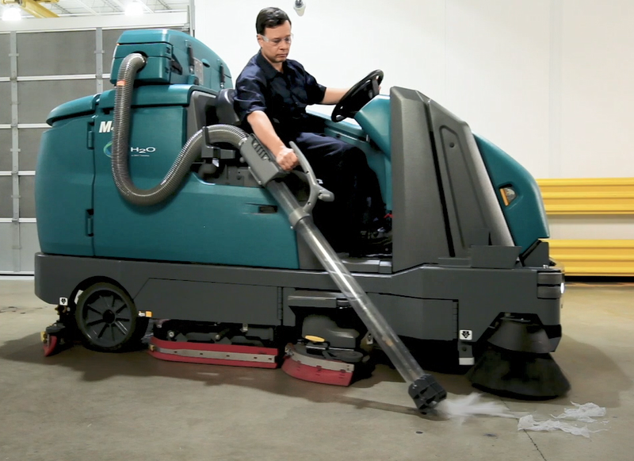
Live Vacuum Wand for M17 and T17
Parked
Ready
Used (held by operator – machine will slow down)
2
1
2
3

Slide 3
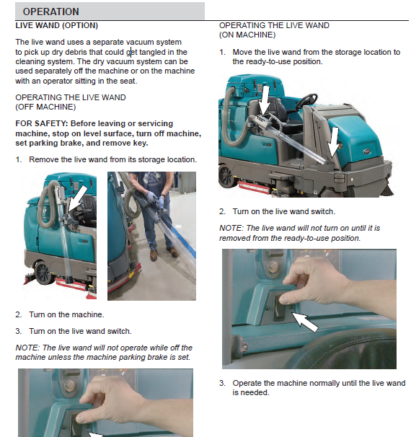
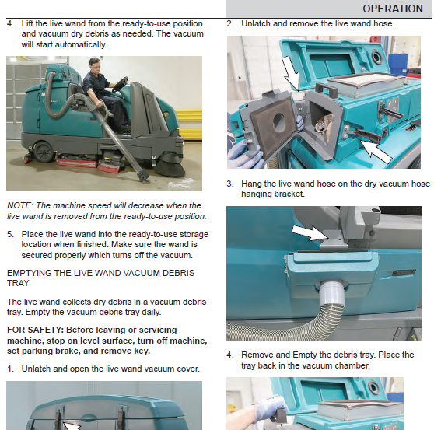
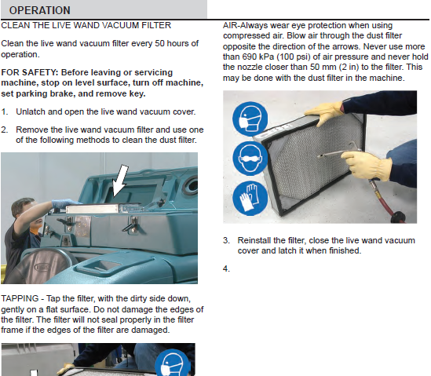
See operator manual for more detail
https://www.tennantco.com/en_us/manuals.html

Slide 4
Specifications
Hopper capacity: 15,6 l
There is no warning light when hopper is full. Suction performance will drop.
Hopper can be emptied via easy slide-out tray
Filter area: 1,9 m²
Wand inner diameter: 73 mm
Reach (when standing next to machine): 4 m
Airflow: 5,66 m³/min

